Slide 1


KONKAN GYANPEETH COLLEGE OF ENGINEERING, KARJAT Affiliated to University of Mumbai, Approved by AICTE, New Delhi.
INSURANCE RENEWAL USING ANDROID
PRESENTED BY :
SWATI BHAGAT (ROLL NO.04)
KHUSHAL PATIL (ROLL NO.44)
DNYANESHWARI DESAI (ROLL NO.66)
DIKSHA KAKPHALE (ROLL NO.26)
GUIDED BY Prof.M.B.ZEMSE

Slide 2

INDEX
Abstract
Introduction
Literature Survey
Problem statement
Data Flow
Objectives
Requirements
User Interface Design
‘R’ Analysis
Methods
Output
Scope
Conclusion

Slide 3
ABSTRACT
Vehicle Insurance has become as an essential aspect of the daily life playing a significant role in providing the cover mainly to the road vehicles and third party lives and property against accidental damage and many other perils including the natural disasters.
Insurance is a product sold by insurance companies, which insures the customers stability by transferring loss risks over to the company.
We are asked to produce a pricing model to predict the pure premium of policy holders, and we are to be evaluated on the model performance using Ginni coefficient.

Slide 4
INTRODUCTION
General insurance is the right term for all the insecurities and worries. Only buying online insurance is not enough instead, online insurance renewal is also important at the same time.
Every single person in Indian Territory is responsible for vehicle insurance as it is mandated as per government regulation.
Initially, buying insurance as well as insurance renewal used to be done by insurance agents. Now, the internet has overpowered the place by making online insurance renewal feasible for people.
The introduction of Vehicle Insurance Renewal application has made insurance renewal process hassle-free. It enables user to register themselves by filling up the form online and selecting a premium renewal option along with giving them option to make the payment online.
The renewal process let’s user receive notifications on their application before their due date of renewal, It also saves them from getting penalty. After making the payment online User will also receive insurance renewed receipt from the company on the application itself. This way user can renew their vehicle insurance simple and instantly.

Slide 5
OBJECTIVES
SOFTWARE AND HARDWARE REQUIREMENTS

Slide 6
PROBLEM STATEMENT
Insurance plays a key in promoting the socioeconomic development of modern economy. It’s a policy where an insurance company promises to pay benefit on the death of the person whose life is insured. However, there is a problems related to insurance industries, which hinders its smooth operation . Some of the problems faced in Insurance such as :
The alarming declining premium rates due to unhealthy competition.
Most branches of the company were concentrated around urban areas.
Lack Of insurance professionalism and training staffs.
Lack of adequate advertising to the promotion of insurance

Slide 7
LITERATURE SURVEY
AUTHOR | TITLE | YEAR | DESCRIPTION
DR.D.M.ARVIND MALIK AND SUHAIB S. | A Study On Customer Awareness On Car Insurance Policies With Special Reference To United India Insurance ,ShivaMogga | 2018 | This Research Study Provide A Clear Information About Policy Holders Awareness Regarding About The Policies Terms And Conditions, Procedure, Vehicle Declaration Value ,Settlement Procedure etc. We Found That Respondents Are Not Satisfied With The Claiming Procedure During The Time Of settlements, they Are Expecting United India Insurance Company Provide Claim Settlement Through Within A Short Span Of Time .

Slide 8
AUTHOR | TITLE | YEAR | DESCRIPTION
Chehui, Zhangjiwu | Research On Motor Vehicle Insurance Underwriting Risk Management Model | 2011 | In This Research We Studied That Motor Vehicle Insurance Can Have A Quantitative, more scientific, the Real Description.
Perera S.L, Gamage S.K | Determinents of The Customer Satisfaction In Motor Insurance | 2019 | According To The Correlation Coefficient analysis, It Can Be Identify That There Is A Strong Positive Relationship Between Customer Satisfaction With Behavioral Intention

Slide 9
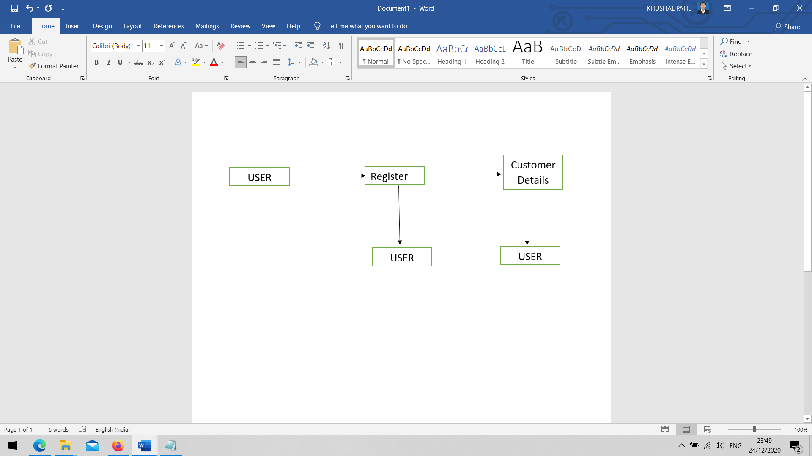
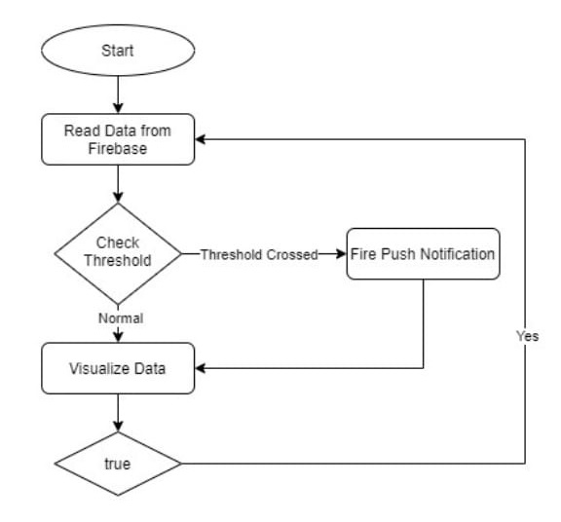
DATA FLOW

Slide 10
‘R’ ANALYSIS
VARIABLE | DESCRIPTION
Veh_value | Vehicle value, in 10000s
exposure | Proportion of year of policy held, ranging from 0-1
clm | Occurrence of claim (0=No, 1=Yes)
Num claims | Number of claims
Claim cst0 | Claim amount (0 if no claim)
Veh_body | Type of vehicle body
gender | Gender of driver (M,F)
area | Drivers area of residence (A,B,C,D,E,F)
agecat | Drivers age category, ordinal scale from 1(young)-6(old)
Variables in Data

Slide 11
METHODS
REGRESSION MODEL
SELECTION OF VARIABLES
EVALUATION AND VALIDATION

Slide 12
REGRESSION MODEL
SELECTION VARIABLE
Cost Of Claimcst0 As A Product Of The Frequency Of Claims And The Severity Of Claim.
Frequency Of Claim numclaims
Severity Of Claim claimcst0/numclaims
Pure Premium = Frequency * Severity = numclaims * (claimcst0/numclaims)
The Final Formulas determined through variable selection
Frequency ∼ oset(log(exposure)) + factor(agecat) + area + veh_value + veh_age + veg_value:veh_age + area:veh_value Severity ∼ gender + veh_age + agecat

Slide 13
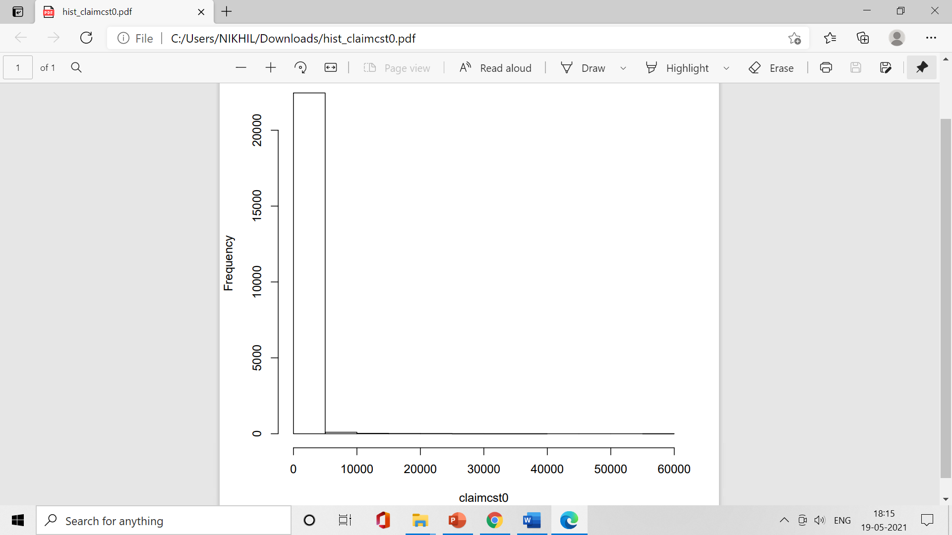
Histogram of claimcst

Slide 14
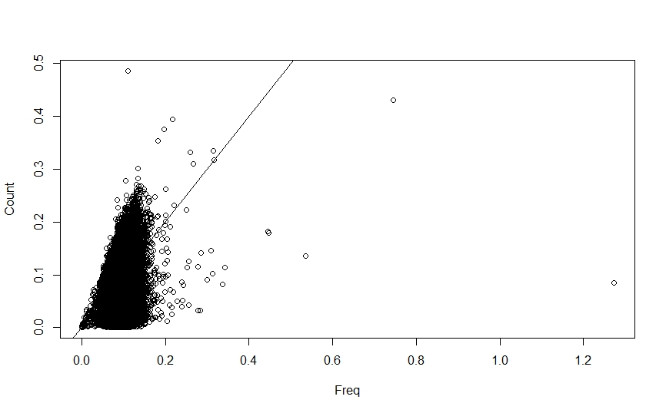
RPLOT

Slide 15
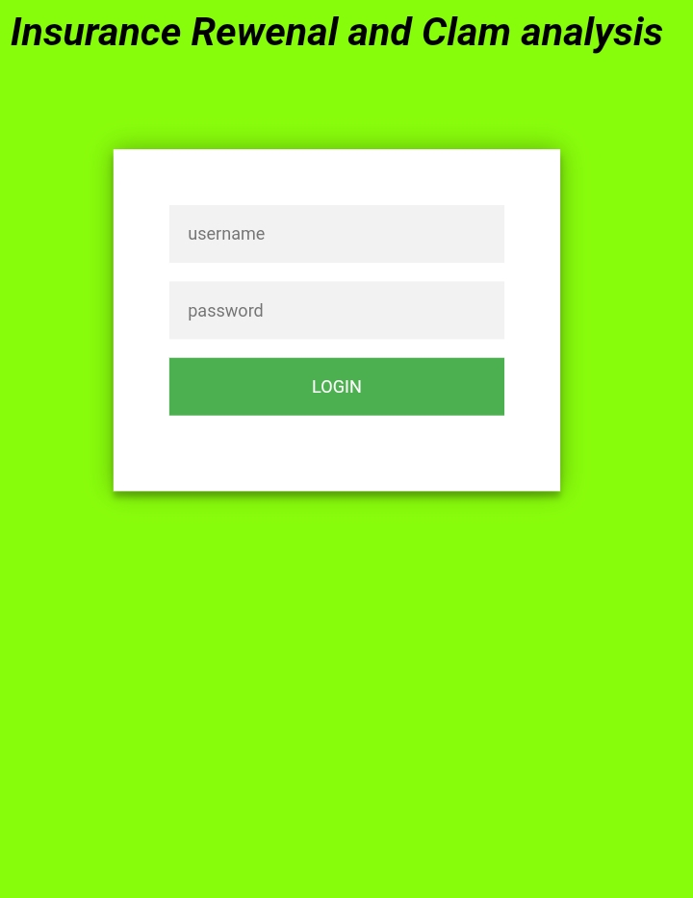
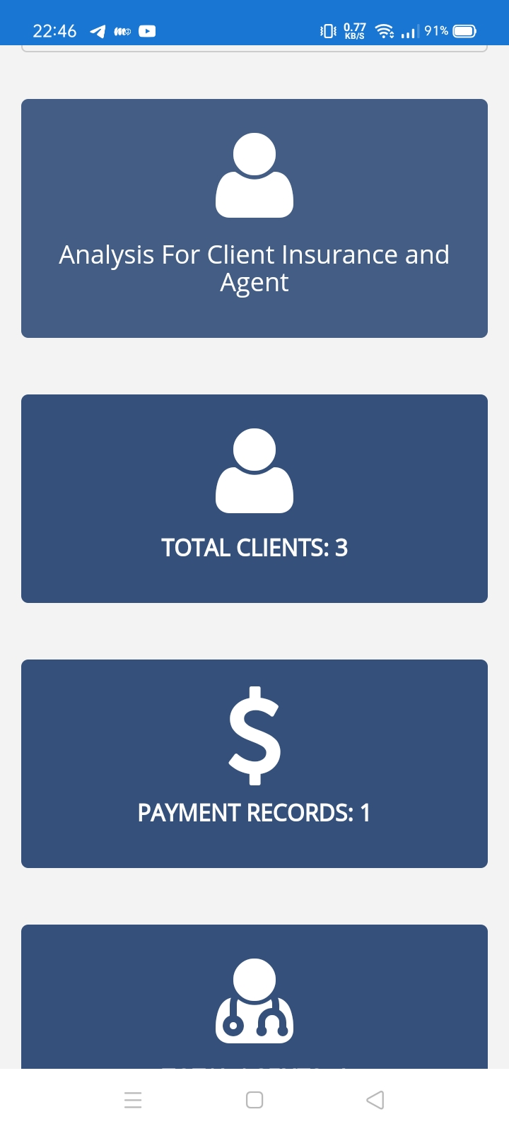
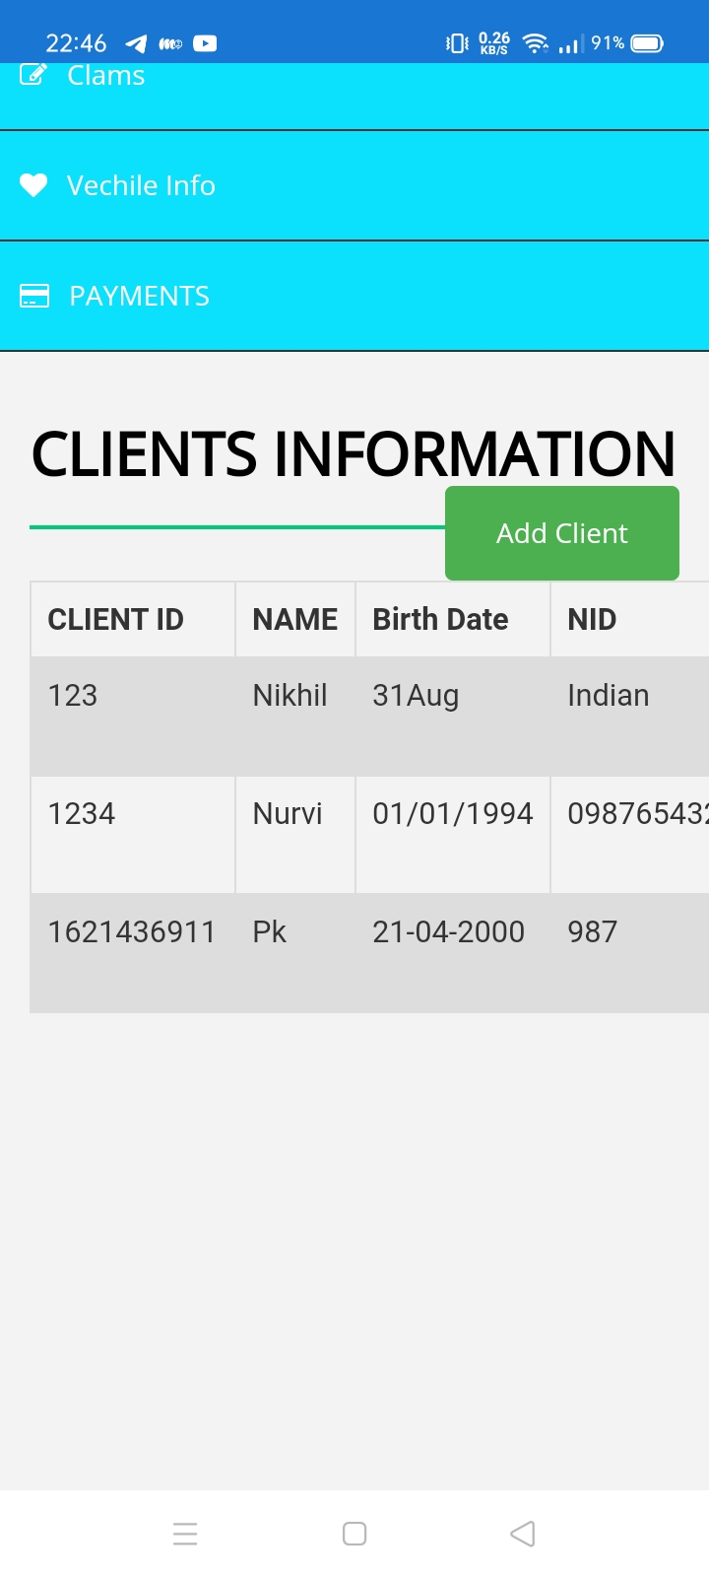
OUTPUT

Slide 16
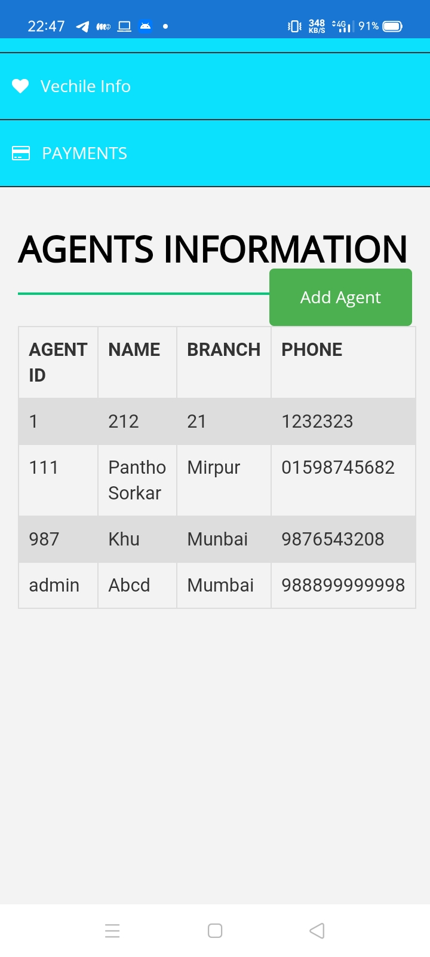
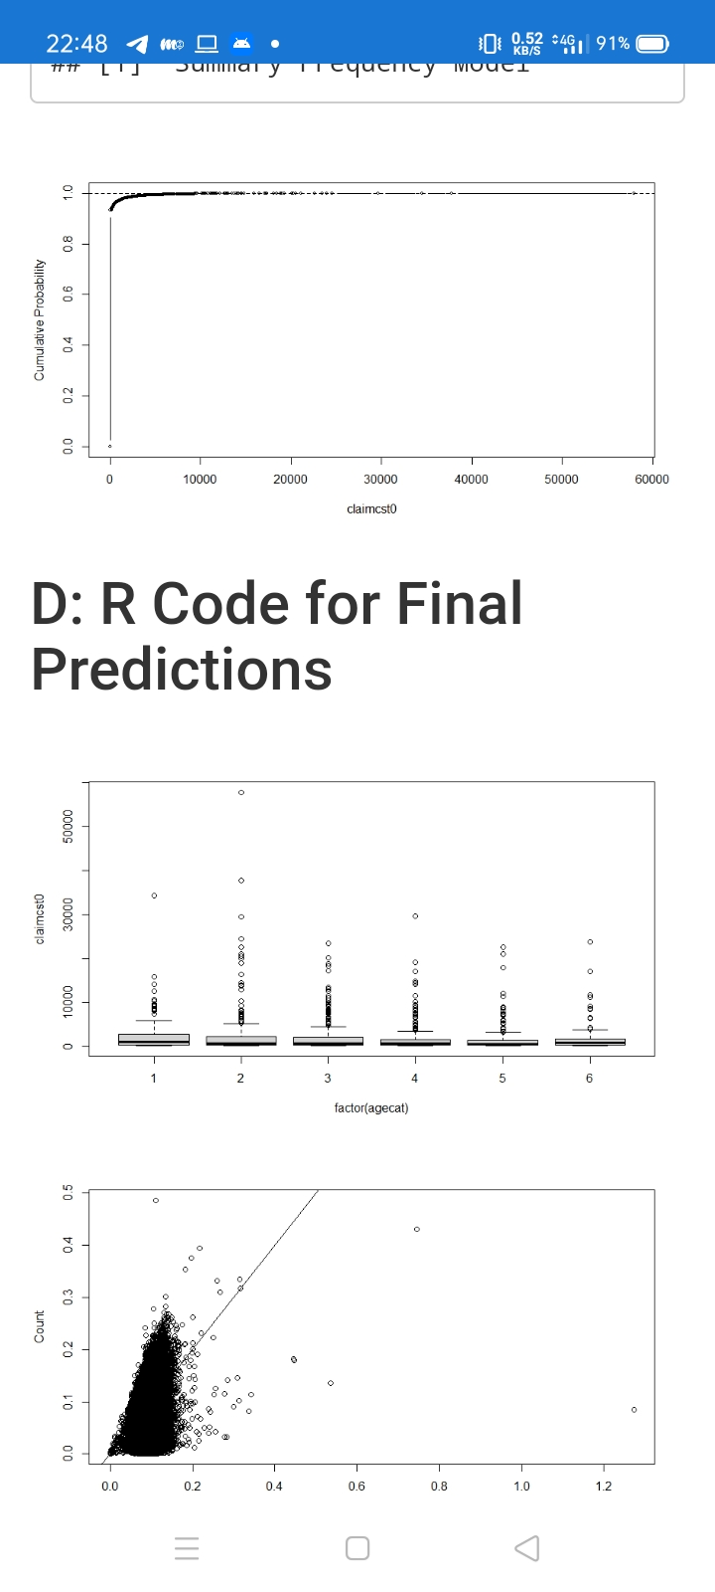
OUTPUT

Slide 17
Future Scope of the Project
More payment options such payment gateway, bank prepaid cards, etc can be add
User can see the nearby insurance companies to their locations
More can companies can be added for better options for users and insurance companies as well.
OCR can be introduced to scan the details of the documents.

Slide 18
CONCLUSION
By the implementation of this application, there will be a transparency in the field of vehicle insurance and it will help in the centralization of insurance renewal, by making user-friendly online payment options for end users.
There will be messages in the form of notifications sent to users before their due date of expiring. It will help them not to get any penalty. There will be an option to upload documents.
So it will eventually save the physical work of users by making it quick. Better insurance policies and premiums can be selected in the application.
Such system implemented will be a result in various helps to the user as well as the insurance companies.
Through exploring various regression models to predict the total claim loss claimcst0, we found that the two-part model of Pure Premium = Frequency*Severity was the best approach.

